Slide 1
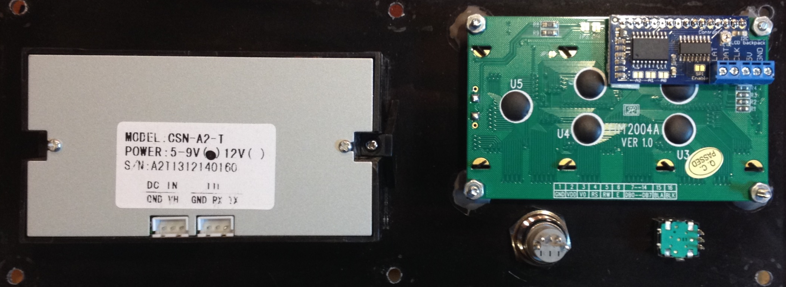
Panel Wiring
2 x 6 Male Connector
Pins Facing Out
Ptr RX
Ptr TX
LCD Clk
Enc
LCD Dat
Enc
Usr Button
Select Button
Gnd
+5v

Slide 2
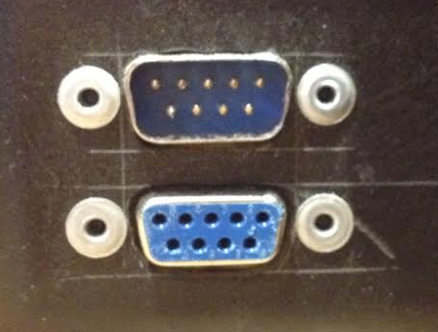
Connectors on Roaster – DB9 - 1
Fan 12v
Drum 12v
Fan PWM
Drum PWM
1
Htr Ctl Gnd
n/c
Htr Ctl ZeroCross
6
Htr Ctl Gate
1
6

Slide 3
Connectors on Roaster – DB9 - 2
1
6
Drum Pos Sw 1
+5v
1
n/c
GND
Drum Pos Sw 2
6
Cs0
D0
Clk
Cs1

Slide 4
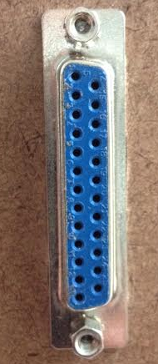
Connector on RoastGenie
1
Fan PWM
14
Htr Ctl Gnd
Fan +12v
n/c
Htr Ctl ZeroCross
Htr Ctl Gate
Drum +12v
n/c
Drum PWM
Gnd
n/c
Cs0
+ 5v
Clk
n/c
Cs1
Drum Pos Sw 1
D0
Drum Pos Sw 2
+ 5v
Gnd
Gnd
+ 5v
AGnd
+ 12v
25
13

Slide 5
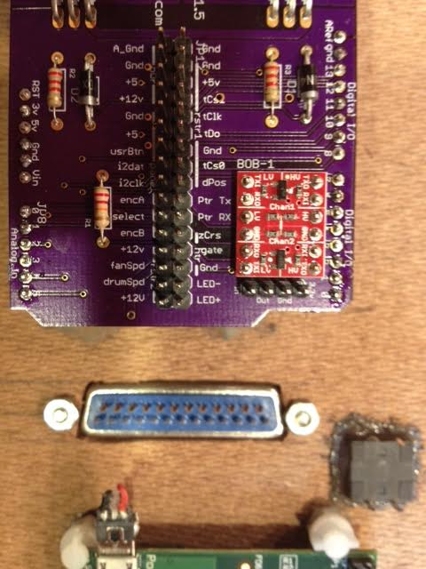
Rx
Tx

Slide 6
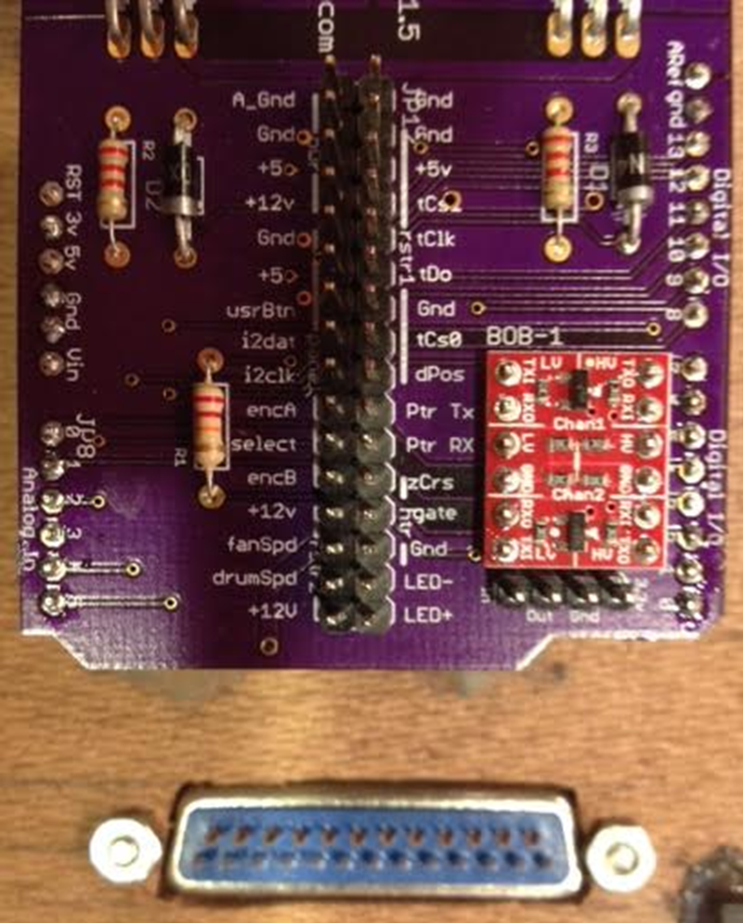
Rx
Tx

Slide 7
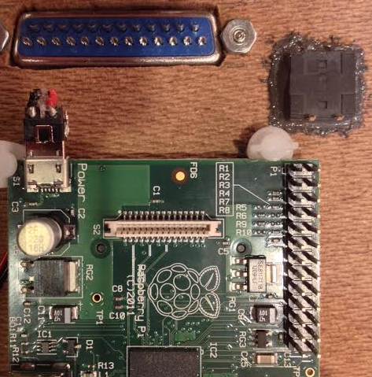
Rx
Tx
RasPi
Shutdown

Slide 8
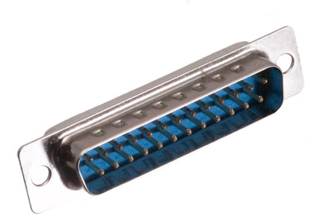
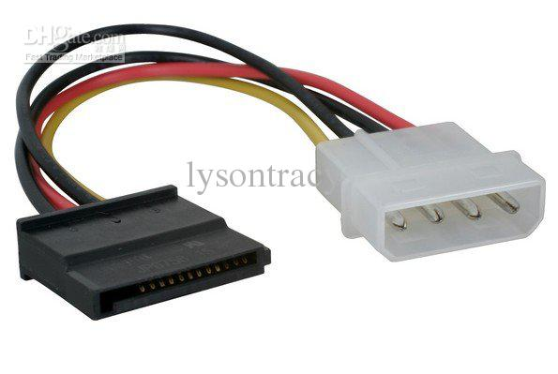
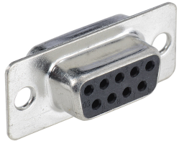
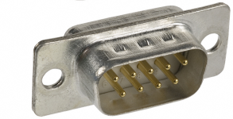
Main Harness
Connector | Pin | Wire Color | Signal | Pin | Connector
J1 | 1 | White | Fan PWM | 1 | J2
J1 | 2 | Yellow | Fan +12v | 2 | J2
J1 | 3 | n/c | n/c | n/c | n/c
J1 | 4 | Yellow | Drum + 12v | 4 | J2
J1 | 5 | Green | Drum PWM | 5 | J2
J1 | 6 | Black | Gnd | 5 | J3
J1 | 7 | Red | +5v | 4 | J3
J1 | 8 | n/c | n/c | 3 | J3
J1 | 9 | Green | Drum Pos | 2 | J3
J1 | 10 | Green | Drum Pos | 1 | J3
J1 | 11 | Red | +5v (raspi) | 4 | J4
J1 | 12 | Red | + 5v | 4 | J4
J1 | 13 | Yellow | + 12v | 1 | J4
J1 | 14 | Green | Htr Gnd | 9 | J2
J1 | 15 | Yellow | Htr ZeroCross | 8 | J2
J1 | 16 | White | Htr Gate | 7 | J2
J1 | 17 | n/c | n/c | 6 | j2
J1 | 18 | n/c | n/c | n/c | n/c
J1 | 19 | White | Cs0 | 9 | J3
J1 | 20 | Green | Clk | 8 | J3
J1 | 21 | White | Cs1 | 7 | J3
J1 | 22 | Yellow | D0 | 6 | J3
J1 | 23 | Black | Gnd | 2 | J4
J1 | 24 | Black | Gnd | 2 | J4
J1 | 25 | Black | AGnd | 3 | J4
13
1
25
J1
14
1
1
J4
J2
6
1
J3
6

